Slide 1
Reception
Chinese New Year
February 2024

Slide 2
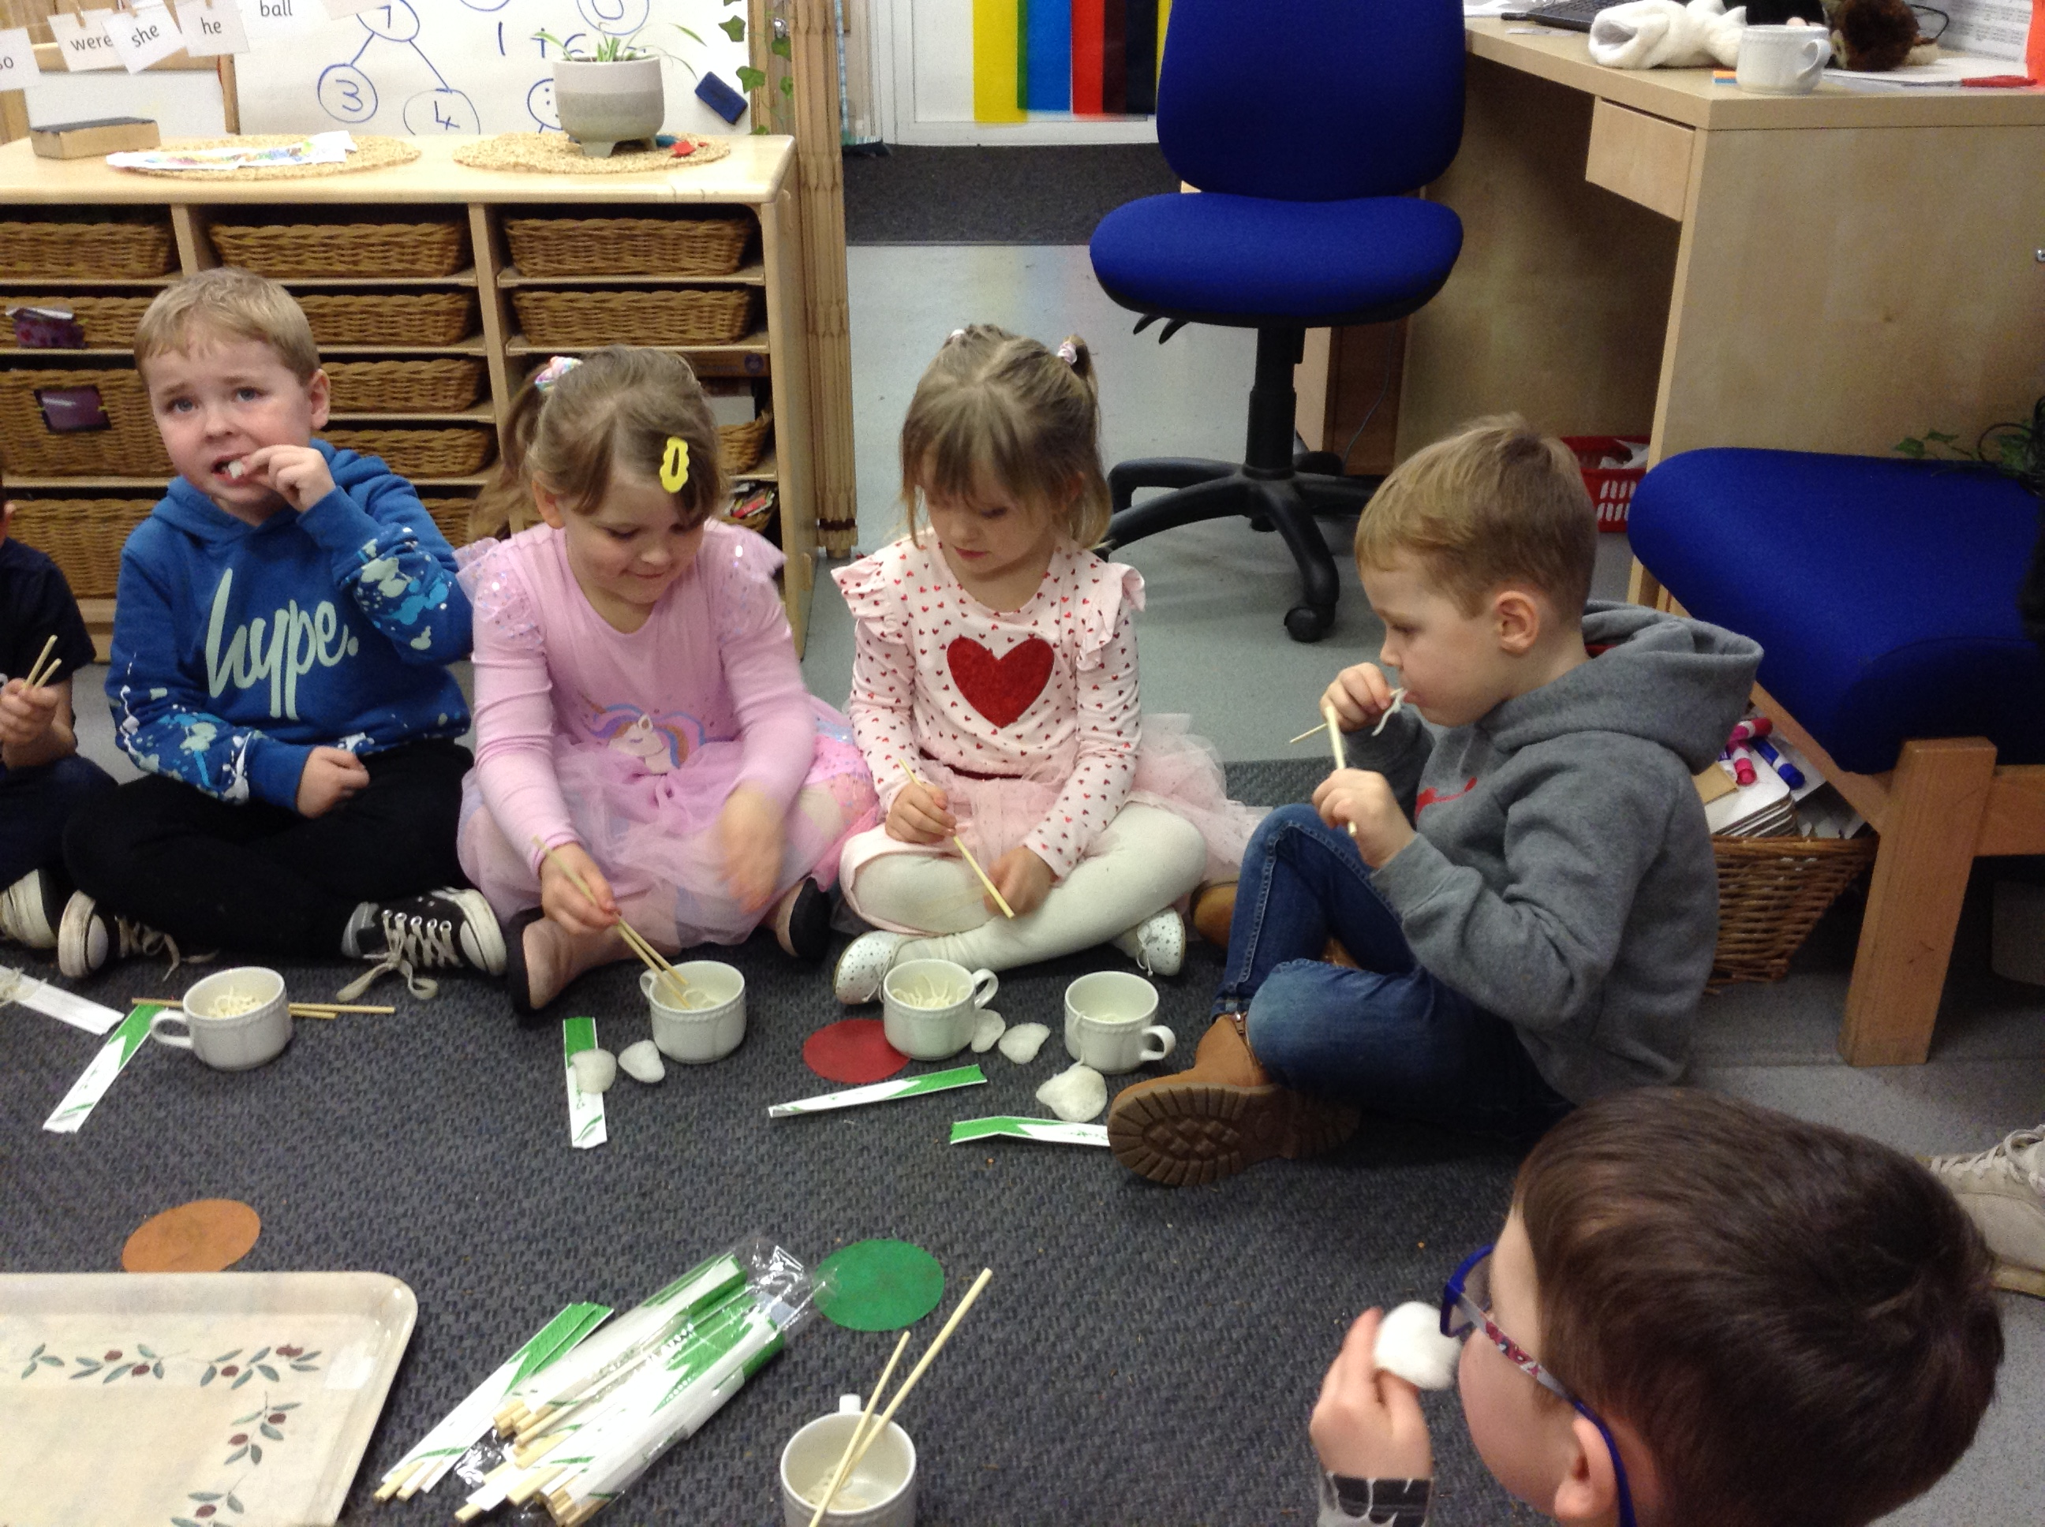
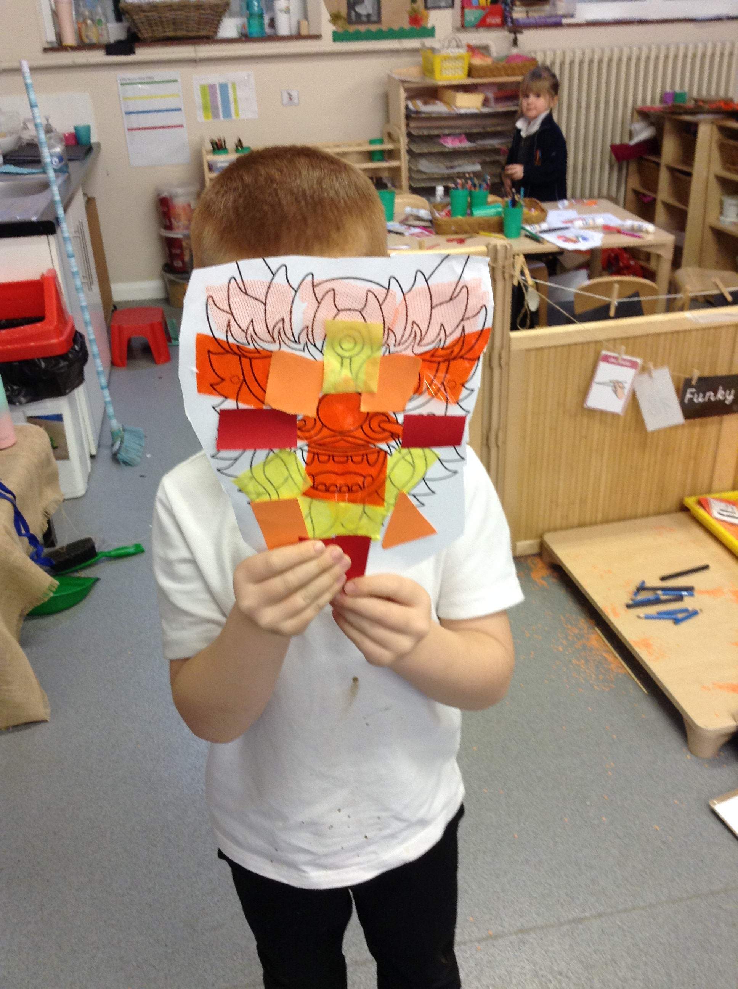
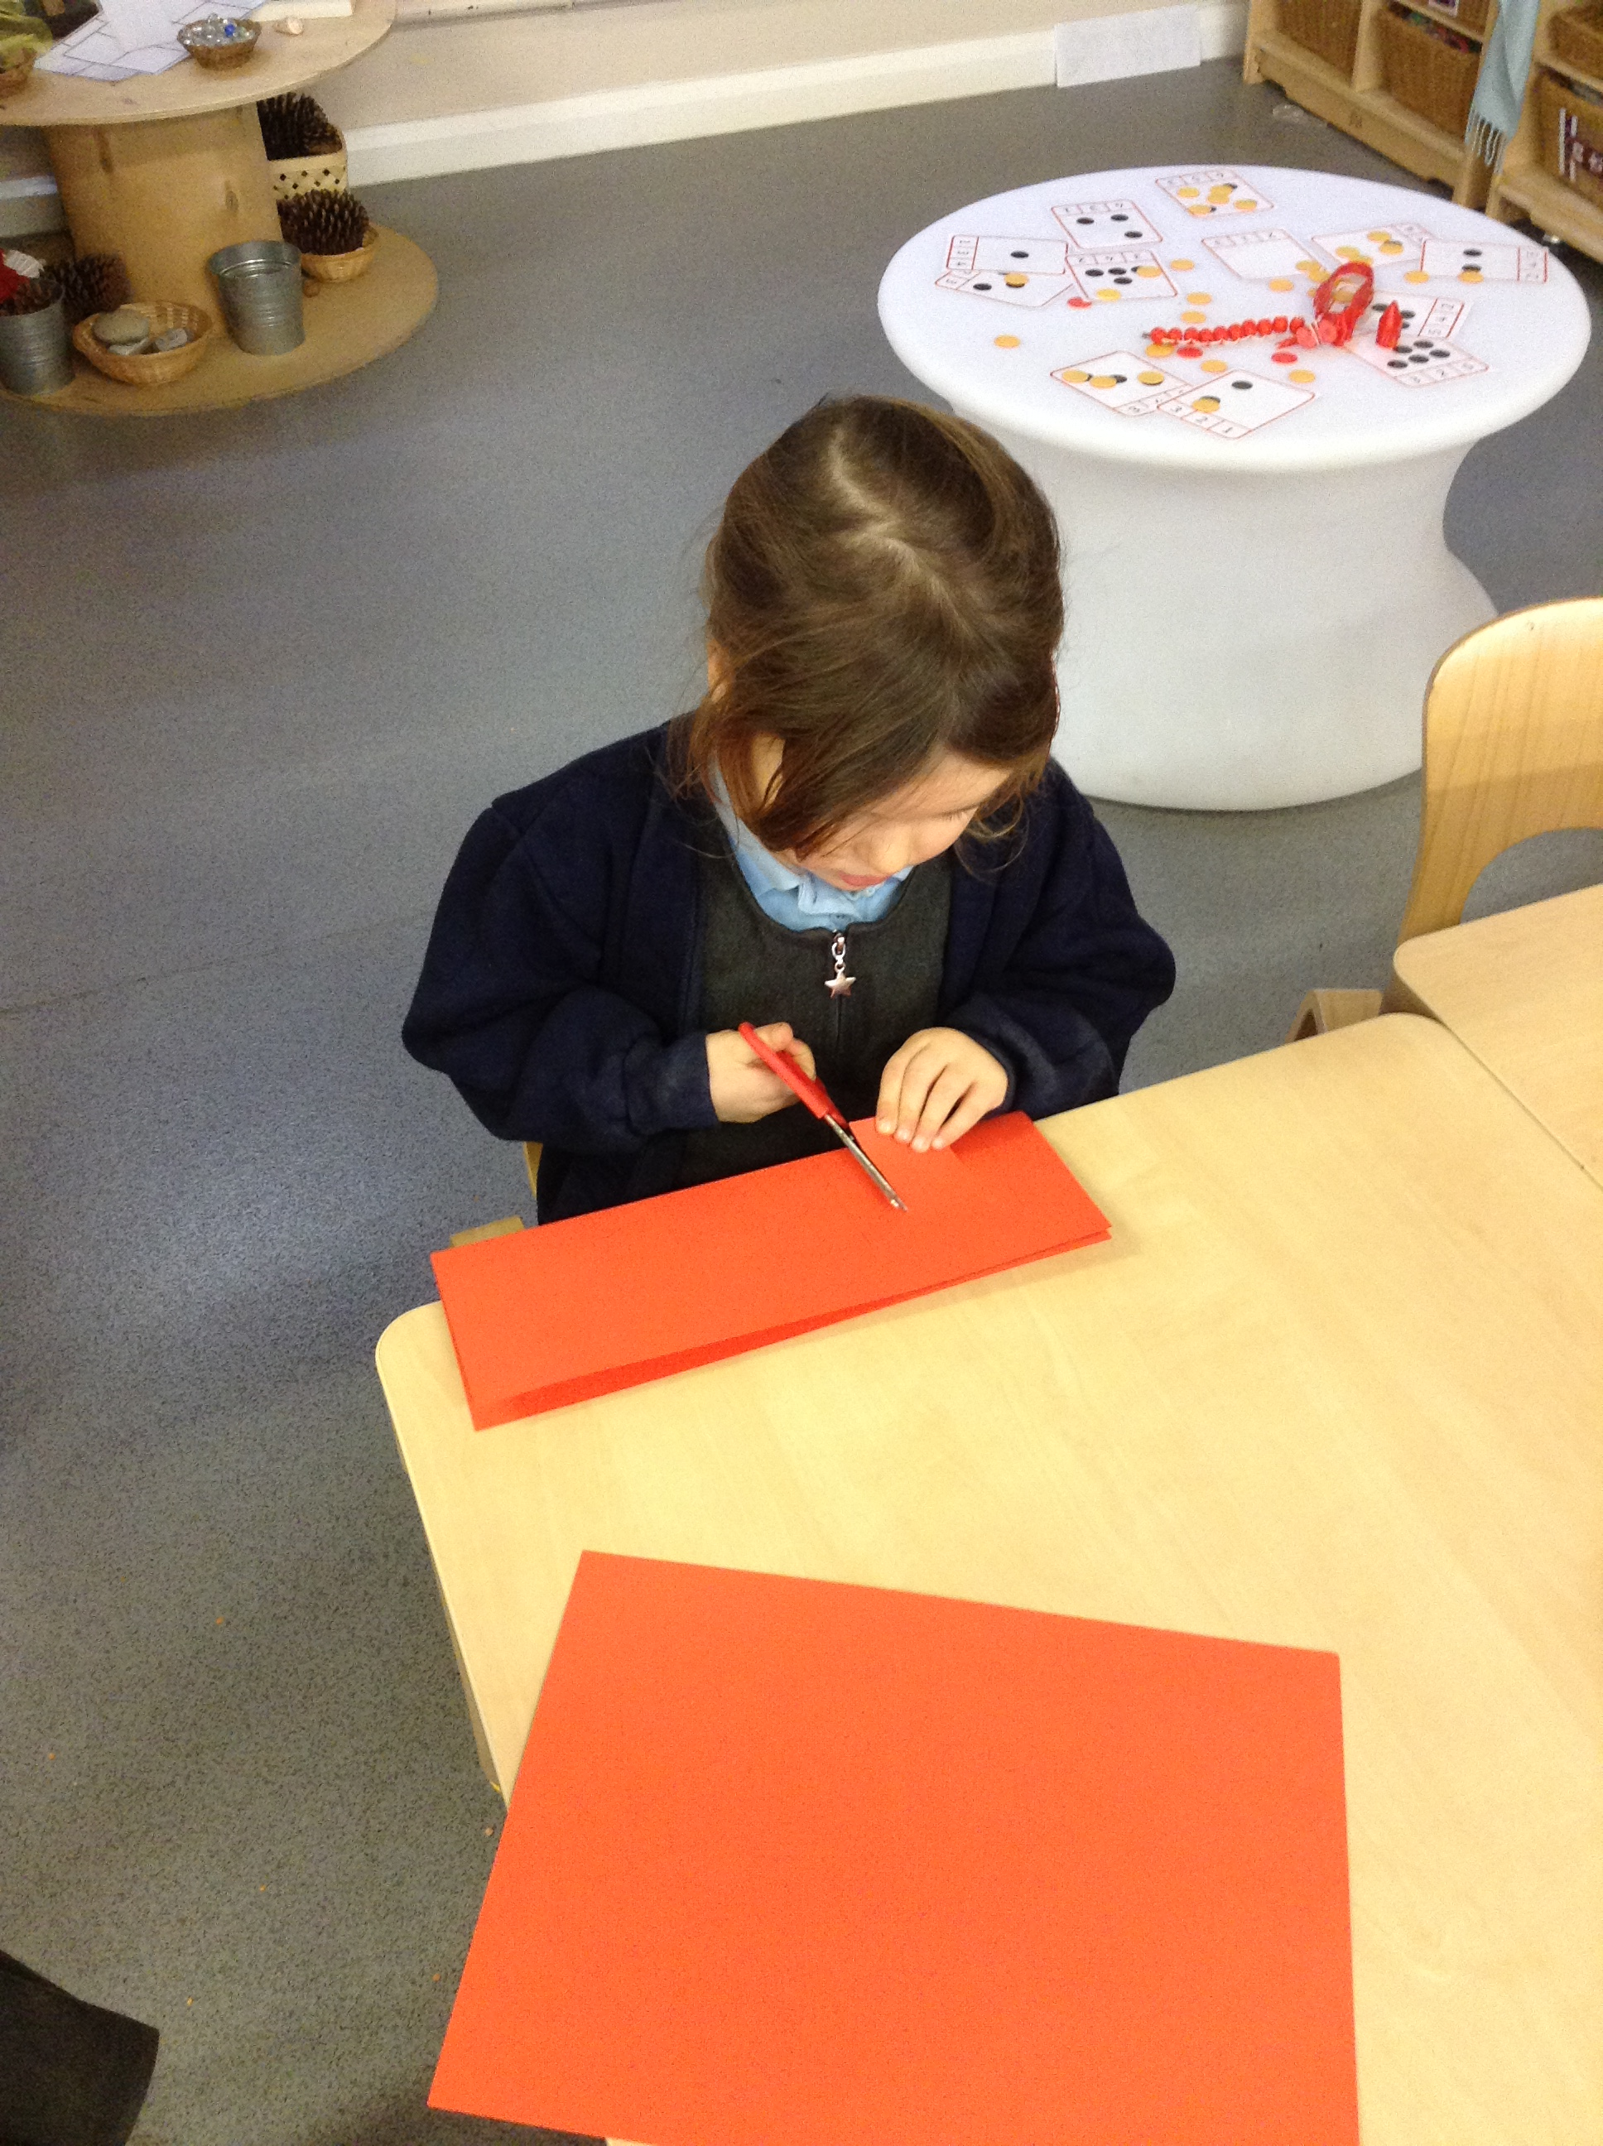
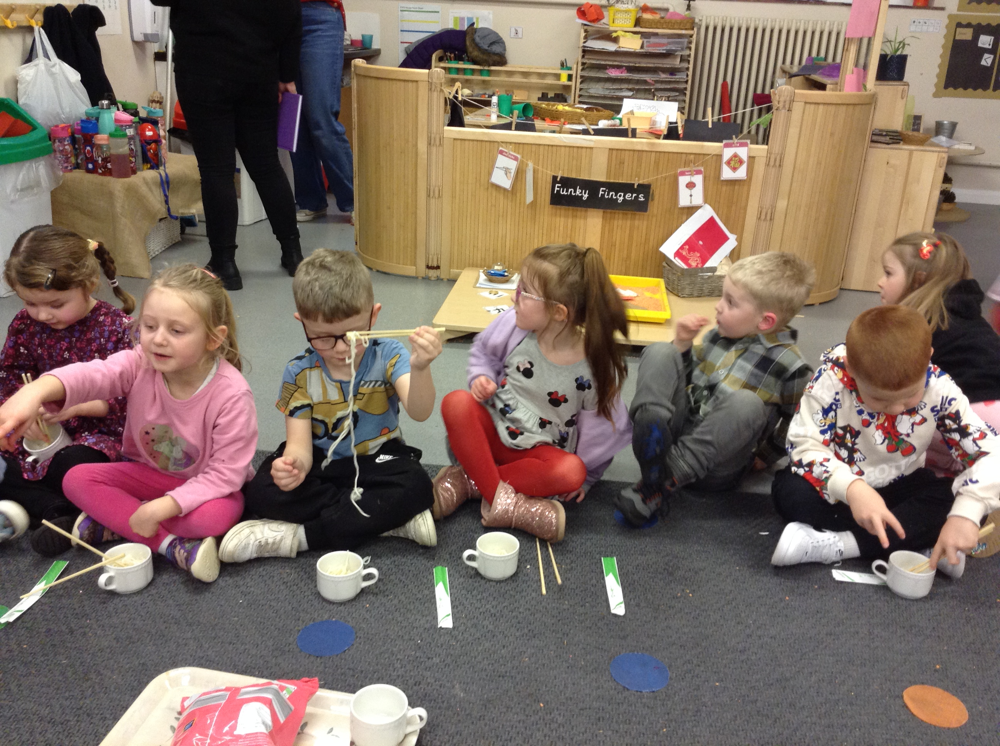
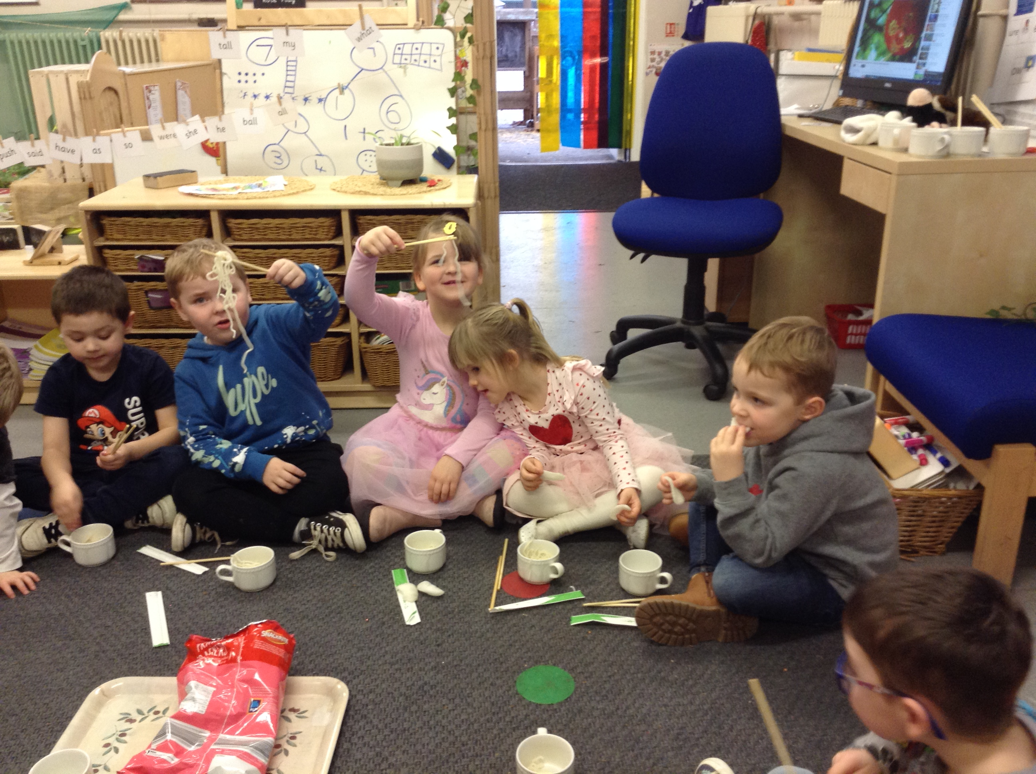
2024 The Year of The Dragon

Slide 3
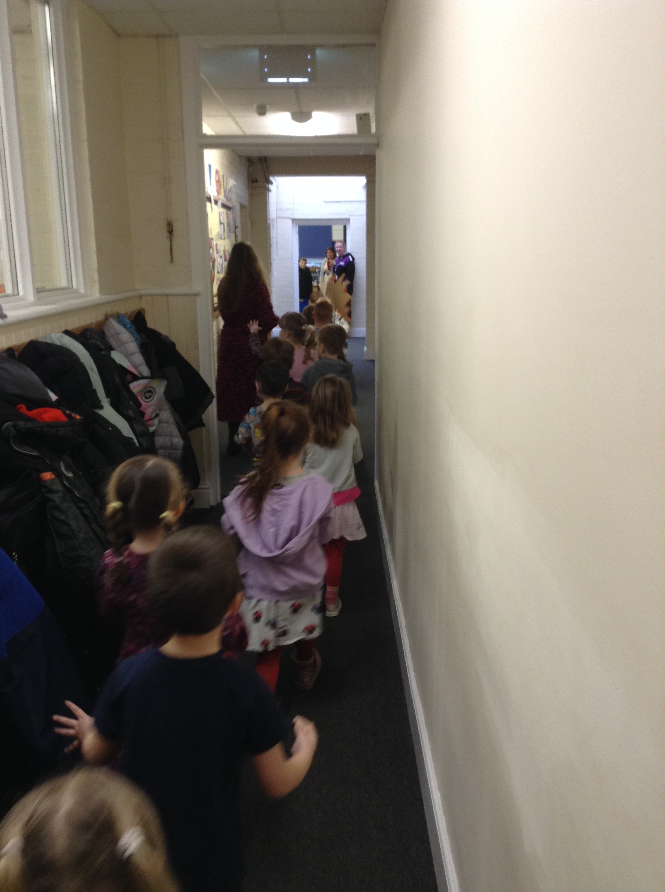
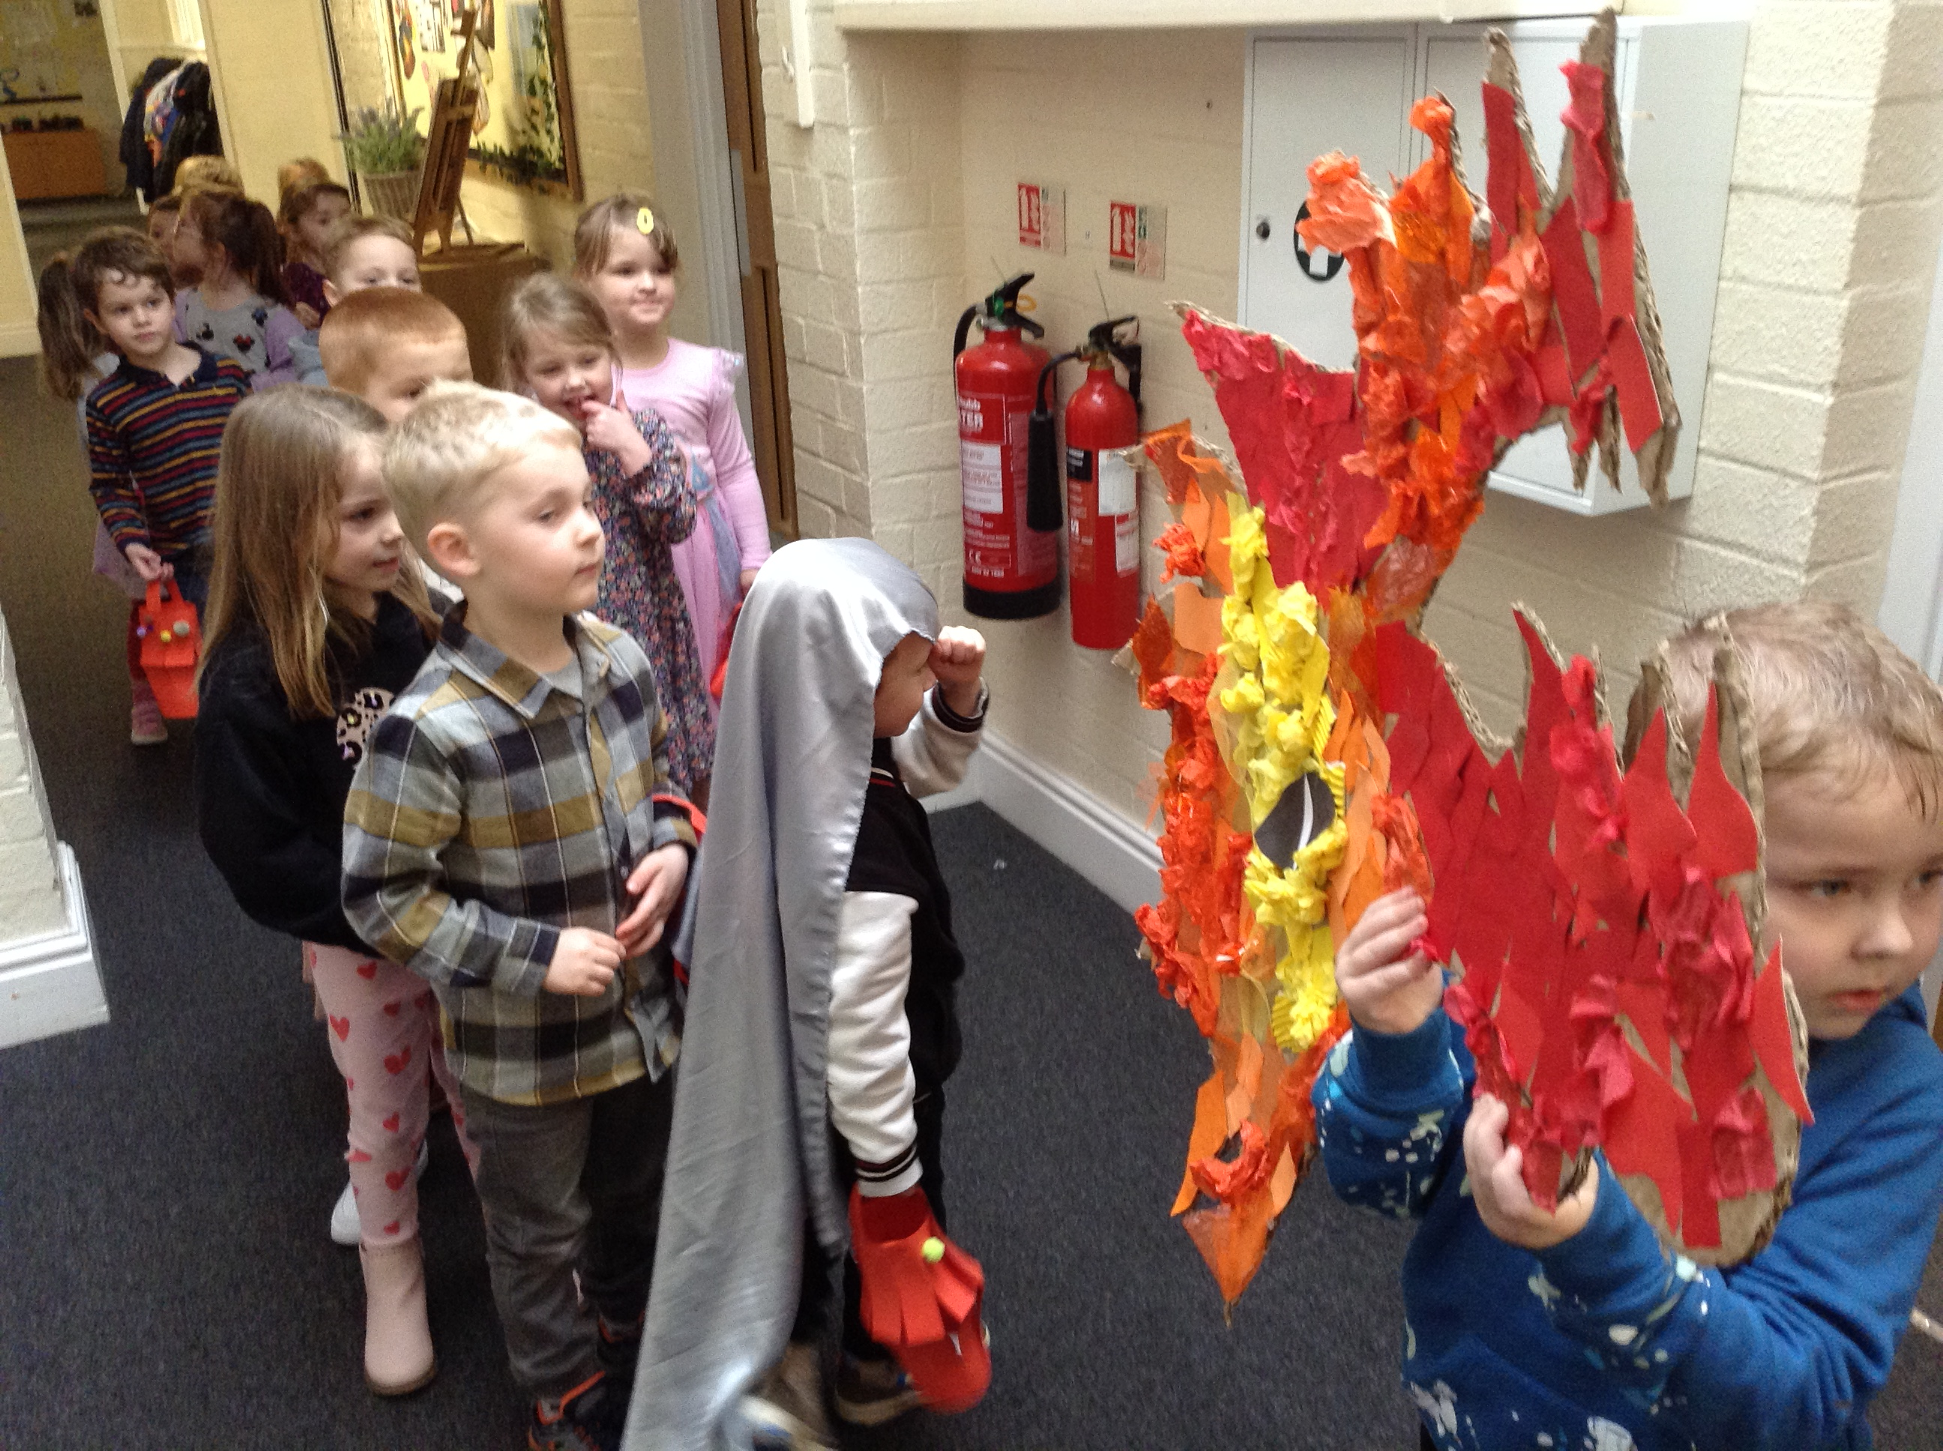
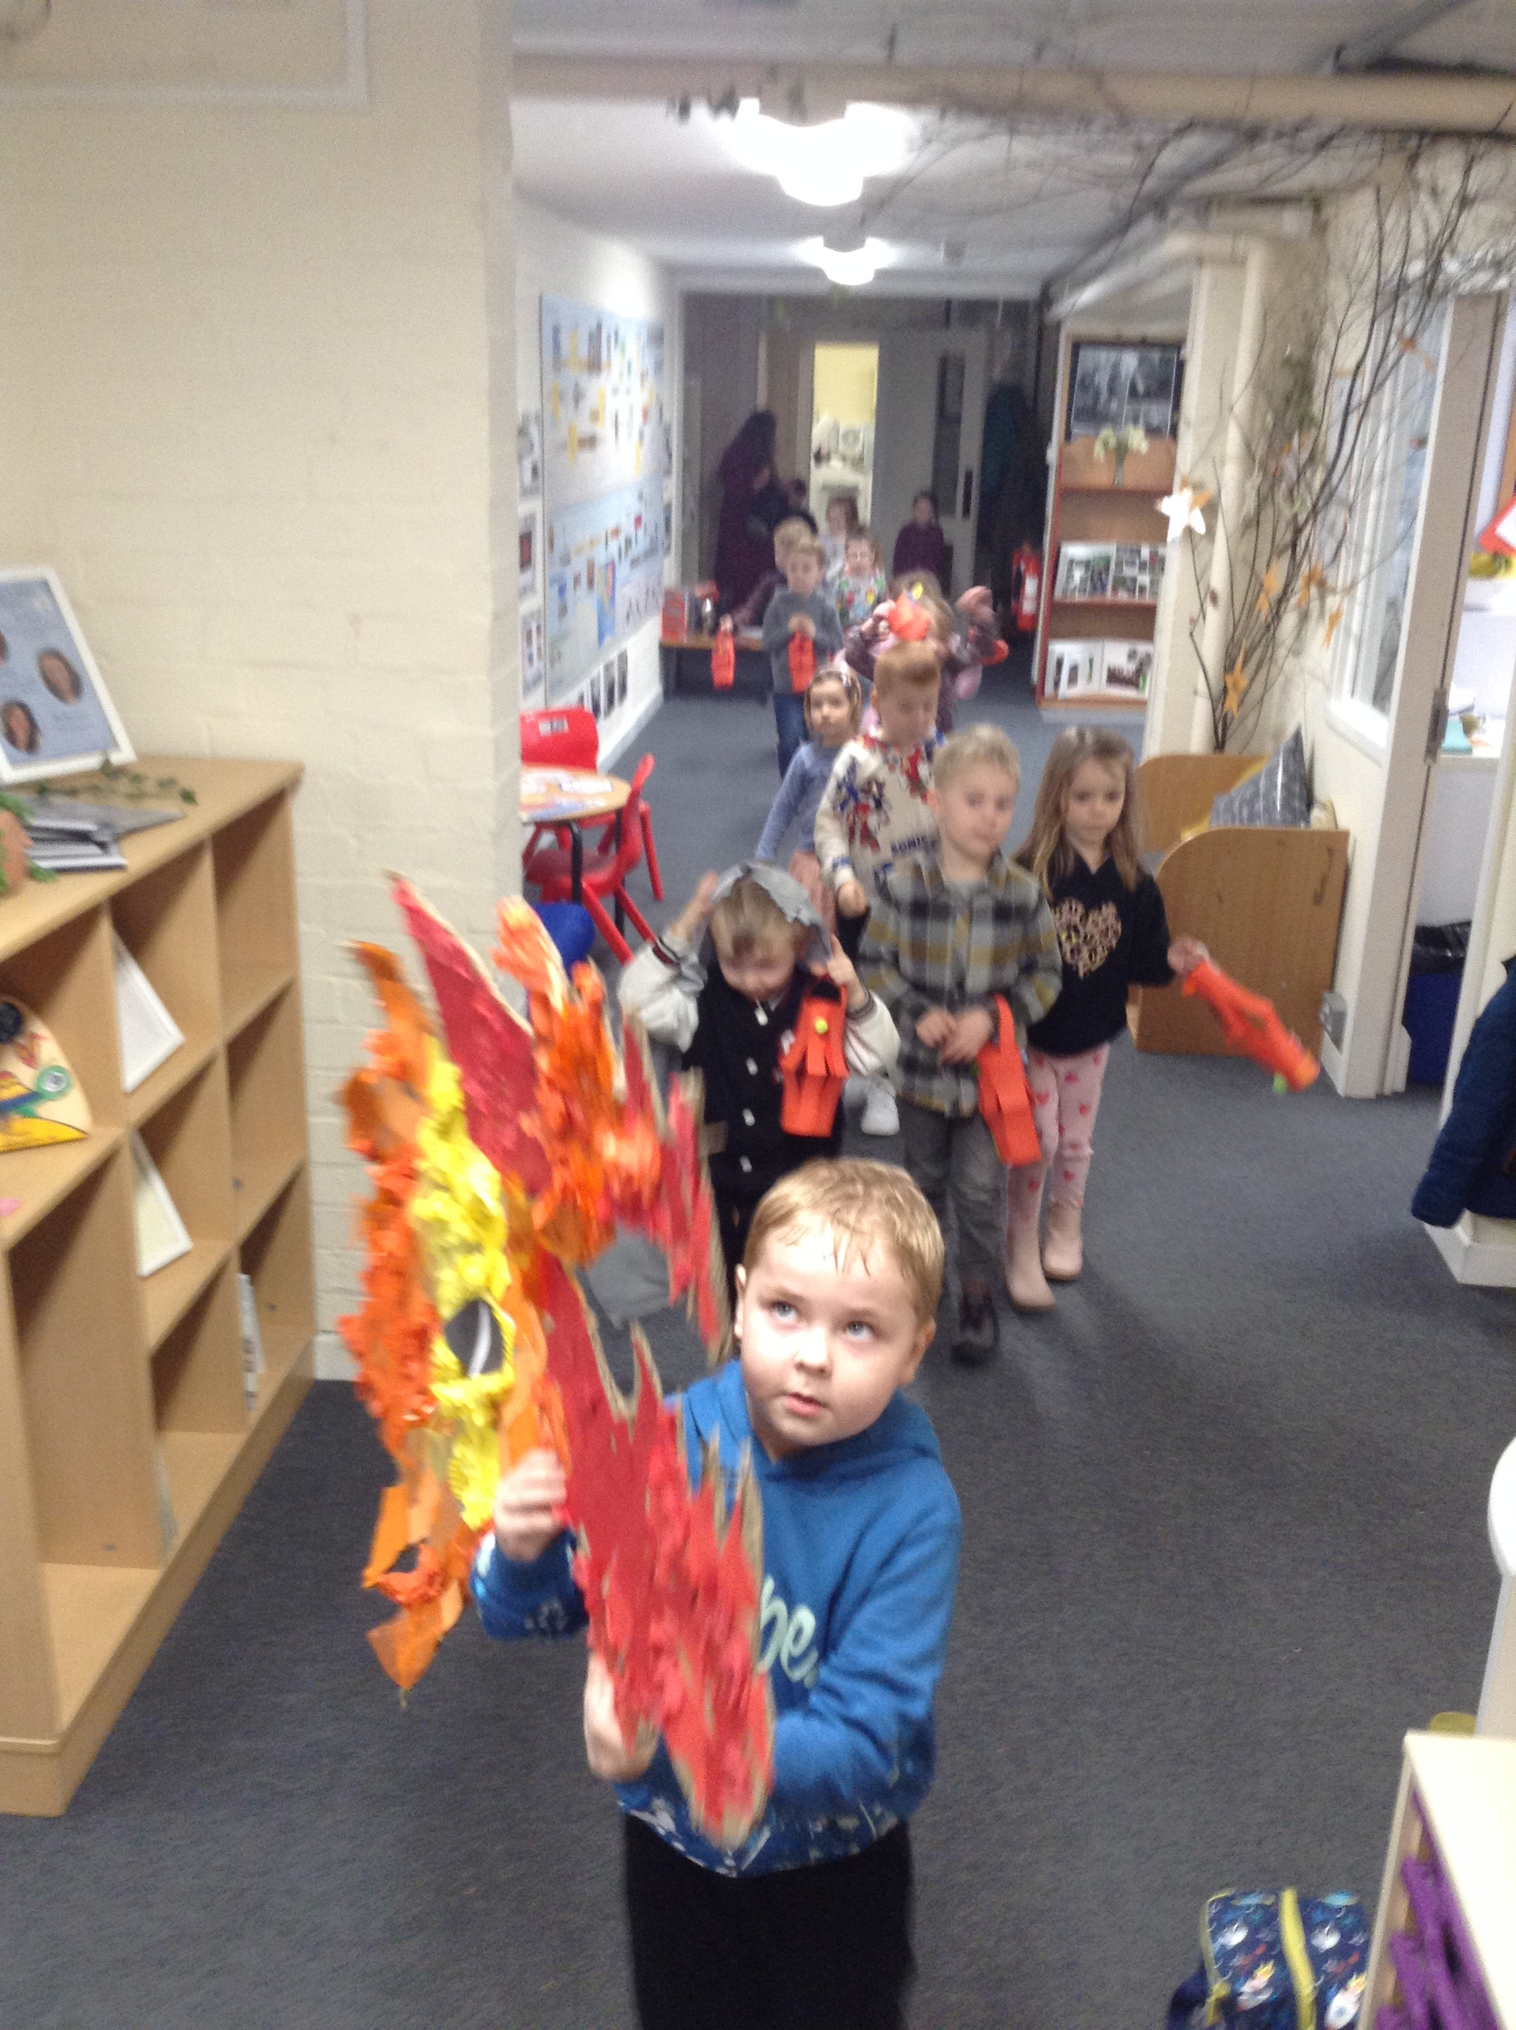

Slide 4
We learned about the different traditions followed to celebrate Chinese New Year.
We made Chinese lanterns, created a dragon, tried Chinese food and even did a traditional dragon dance through school with the dragon we had made!

